Slide 1

Finance Analysis case study-Model N
Go To Market Insights
Presented by Pooja Gupta

Slide 2

Agenda
Data & analytical approach
Key GTM insights
Revenue drivers
Account health
Pipeline & territory performance
Recommendations & next steps

Slide 3
Data & Analytical Approach→

Slide 4

Data & Analytical Approach
CRM-style dataset covering accounts, products, sales pipeline, and sales teams
Python (Pandas) used for data cleaning, validation, and aggregation
Created four business-level summary tables aligned to GTM questions
Power BI used to visualize insights for Finance and GTM stakeholders

Slide 5
Executive Summary
Revenue is concentrated among a small set of products and customers
Sales conversion is consistent; pipeline creation varies by territory
Growth opportunities lie in pipeline expansion and focus on high-value accounts

Slide 6
Product Performance – Revenue Drivers

Slide 7
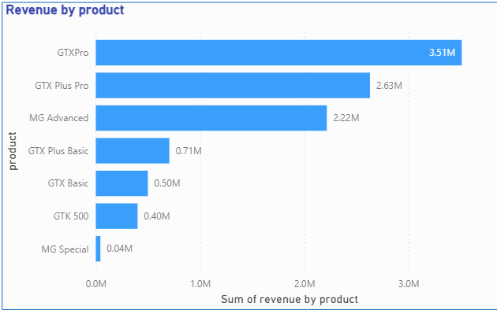
WHAT IS DRIVING REVENUE? (PRODUCTS)

Slide 8
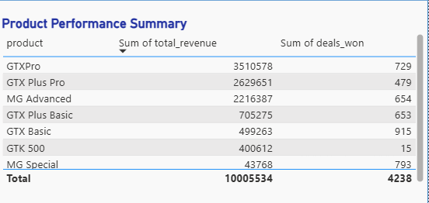
Key Observations:
Top 3 products contribute ~80% of total revenue
High deal volume does not always translate to high revenue

Slide 9
Account Health & High-Value Customers→

Slide 10
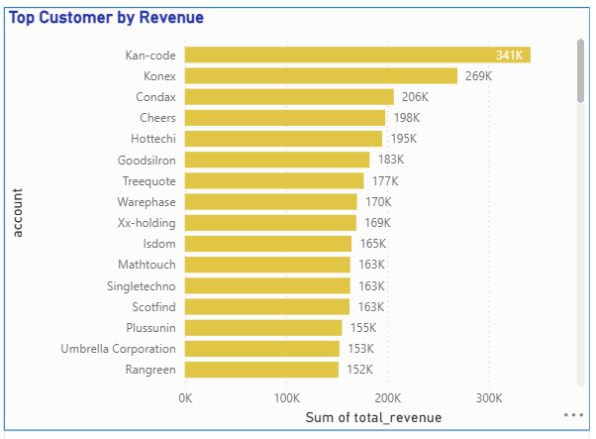
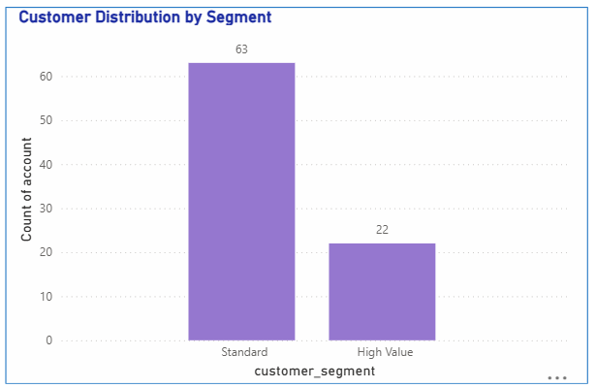

Slide 11
Key Observations
High-value customers represent ~25% of accounts
These customers contribute a disproportionate share of revenue
Revenue is concentrated among a small set of top accounts

Slide 12
GTM Effectiveness – Deal Stage Distribution→

Slide 13
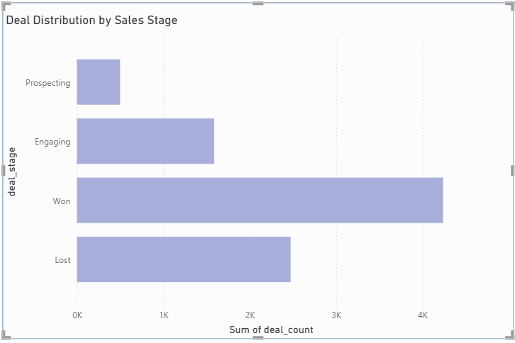
Key Observations:
Majority of deals reach a decision stage (Won or Lost)
Conversion from Engaging to Won is relatively strong
Prospecting volume is comparatively low

Slide 14
Territory Performance→

Slide 15
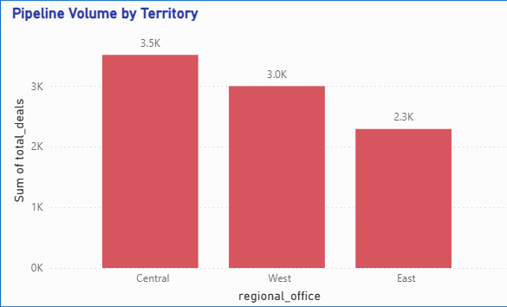
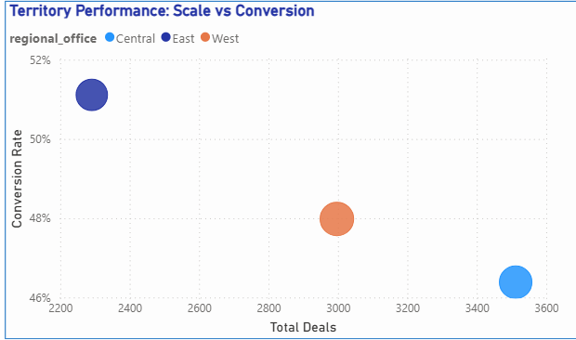

Slide 16
Key Observations
Pipeline creation varies significantly across territories
Conversion rates are relatively consistent by region
Growth opportunity lies in expanding pipeline in lower-volume territories

Slide 17
Cross-sell & Upsell Assessment→

Slide 18
Key Observations
Customers already use multiple products on average
Limited evidence of incremental cross-sell opportunity in this dataset
Growth is more likely through deal size and pipeline expansion

Slide 19
Recommendation & Next Step
Prioritize retention of high-value customers
Focus GTM efforts on high-revenue products
Expand pipeline generation in underrepresented territories
Enhance analysis with time-based trends and usage data

Slide 20

Thank you

